Slide 1
Data Review
December 1 2022

Slide 2
Assumptions/Questions
Outliers
Multi day jobs
>24 hours
Work center level
Activity / head type / material / etc.
# of data points
<10 -- >1000

Slide 3
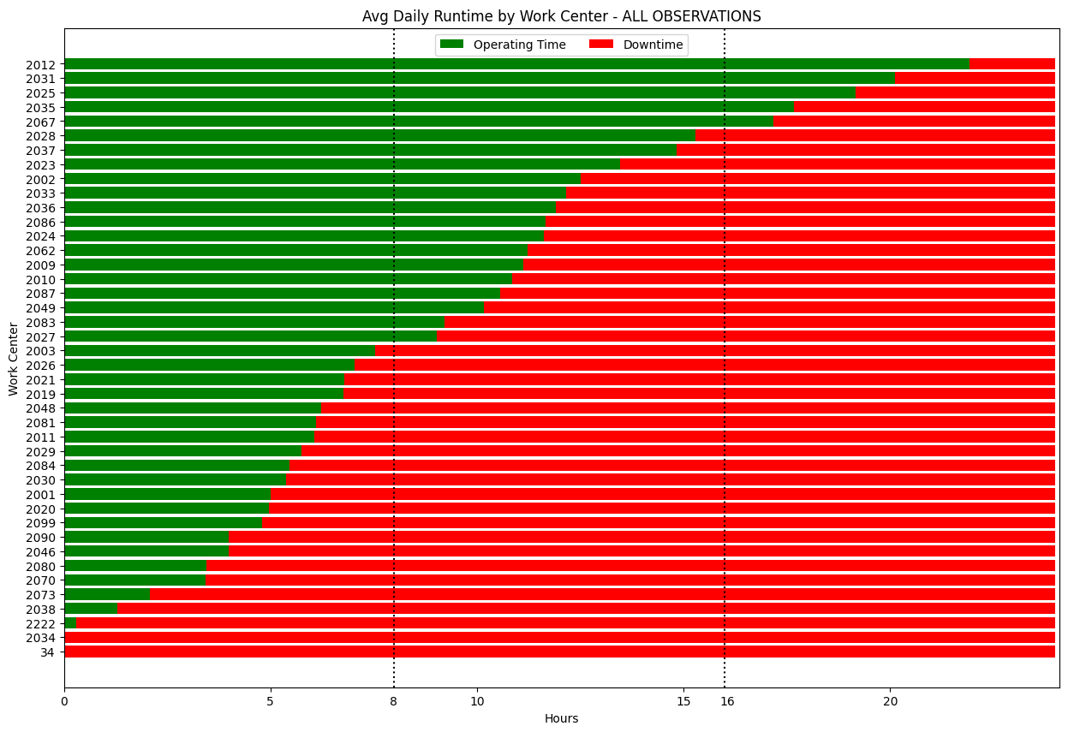

Slide 4
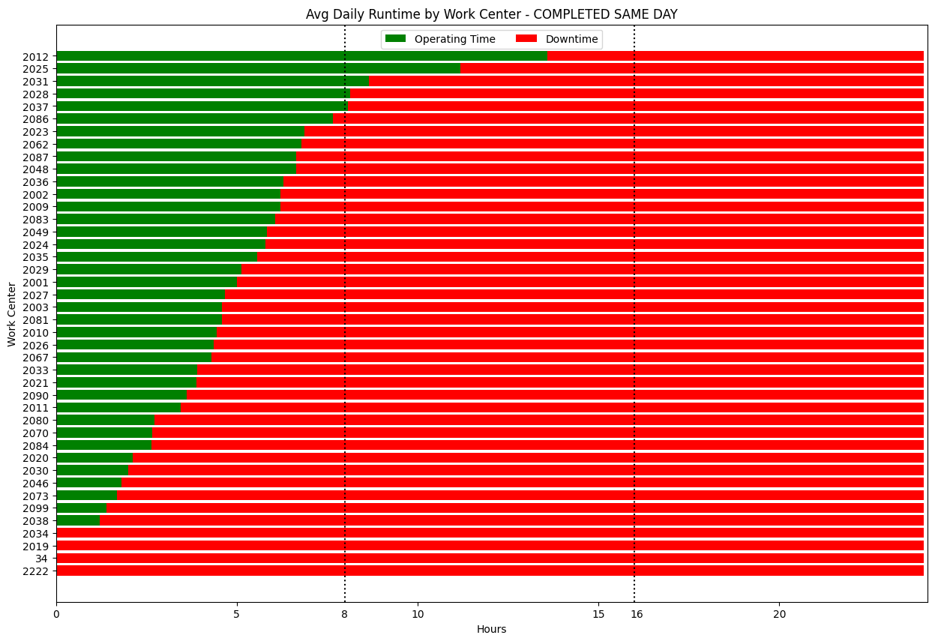

Slide 5
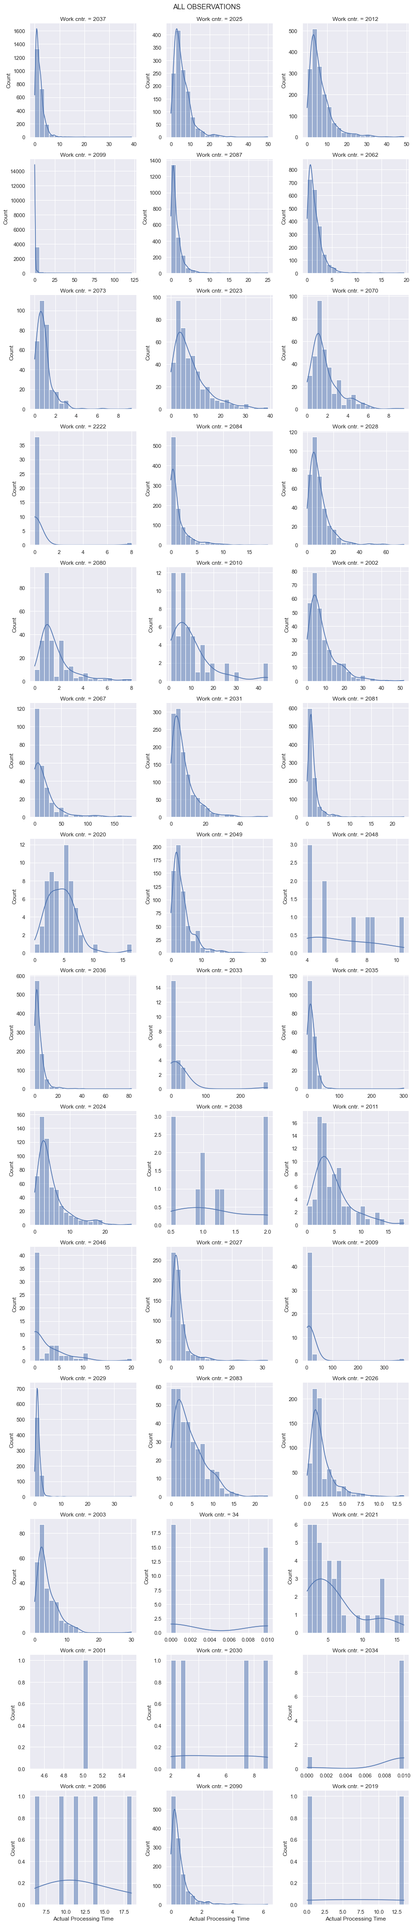

Slide 6
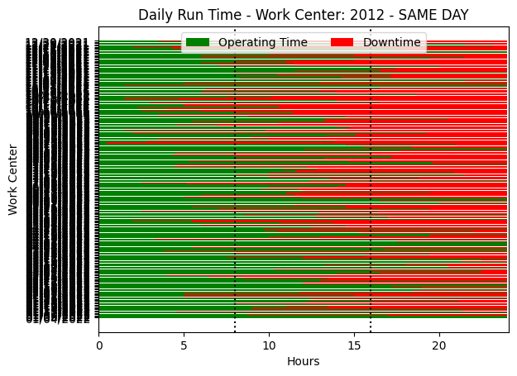

Slide 7
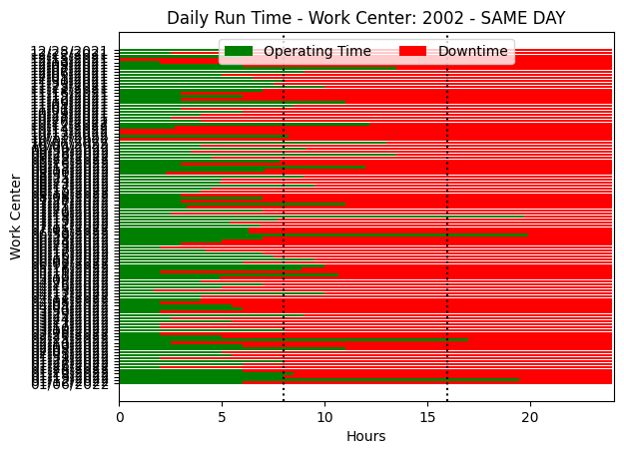

Slide 8
